Slide 1
Instructions
Welcome to our fourth online training session!
Please read through this deck in advance of the next session.
The session will be an interactive video call which will test your understanding of the material!
Please note the homework slide at the end of the deck!

Slide 2
Recap - Product Manager role

Slide 3
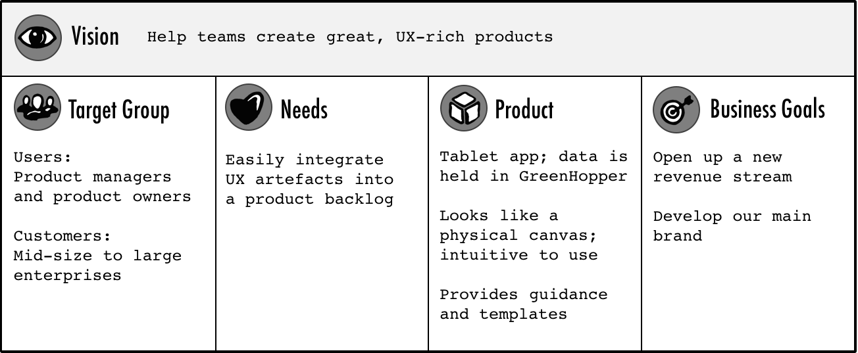
Product Vision
“The product vision is the overarching goal you are aiming for, the reason for creating the product. It provides a continued purpose in an ever-changing world, acts as the product's true north, provides motivation when the going gets tough, and facilitates effective collaboration” Roman Pilcher
Notes:
Alice

Slide 4
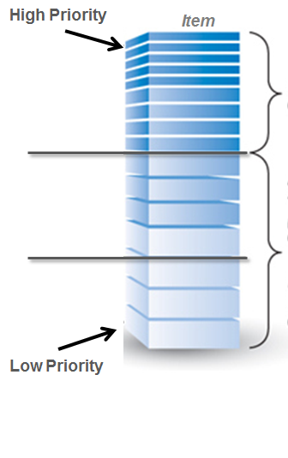
Product Backlog
The agile product backlog an ordered and emerging list of user needs plus anything else that is required to fulfil the product vision. It’s is ever-evolving and never baselined, ‘signed-off’ or static.
High Priority: Items prioritized and a good level of detail provided
Mid Priority: Might prioritise features at this depth based on release schedule
Low Priority: Little effort goes into prioritizing items for future releases

Slide 5
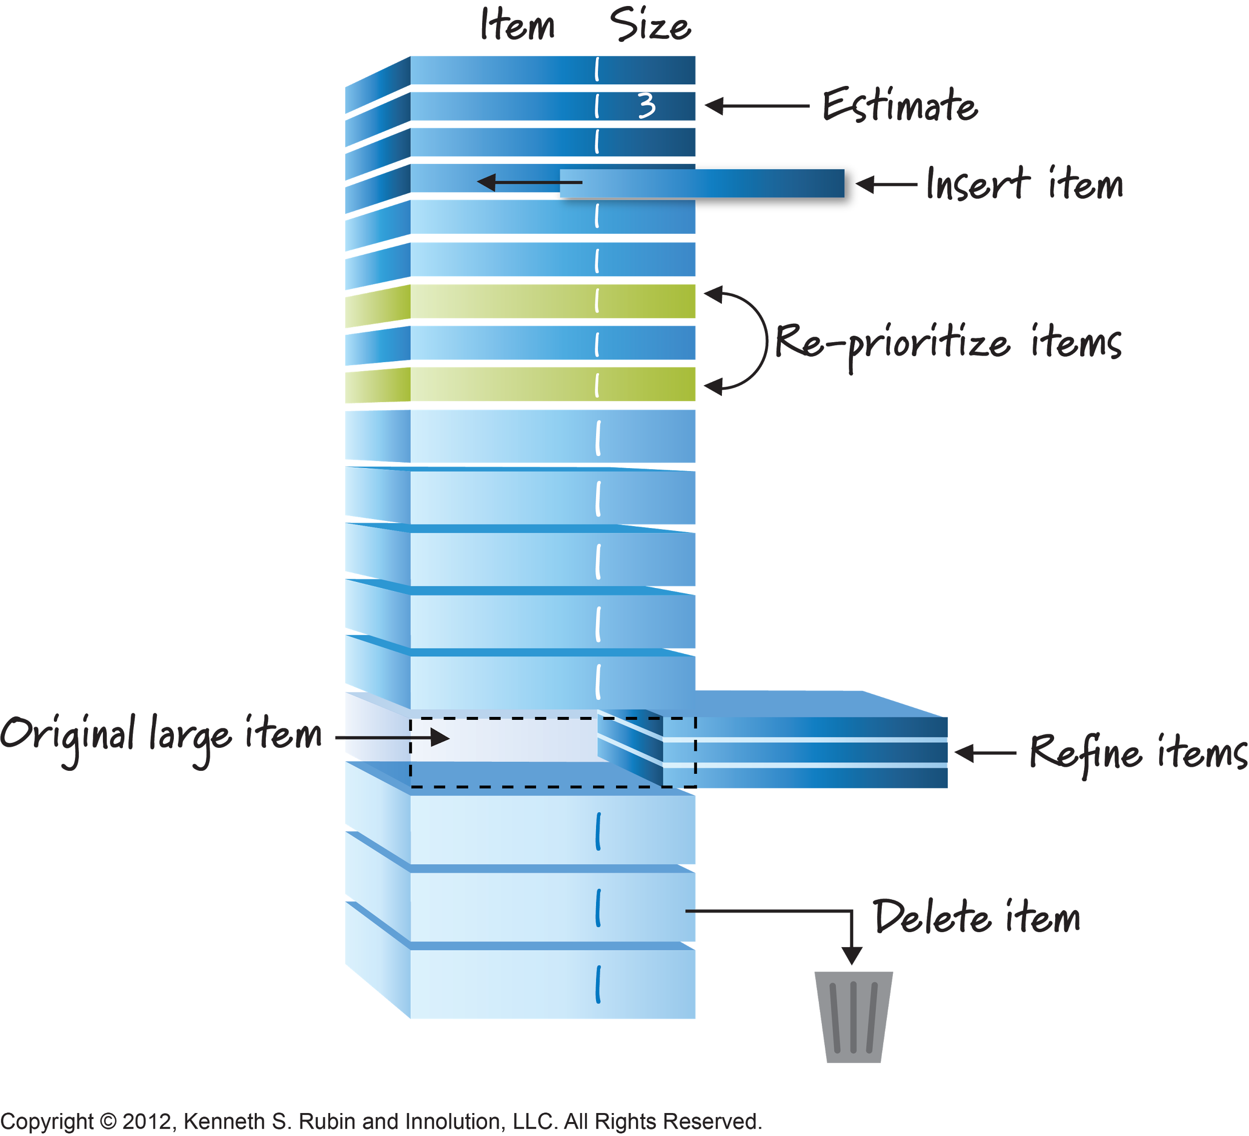
Product Backlog
The product backlog should be continuously refined as you learn more about the needs of the business.
Larger items should be broken down into smaller items that are easier to estimate and deliver.
Items that are no longer required or superseded can be deleted.
New items can be slotted in higher up the backlog (but outside an active sprint).
Your sprint backlog will be made up of ready well defined items at the top of the list.

Slide 6
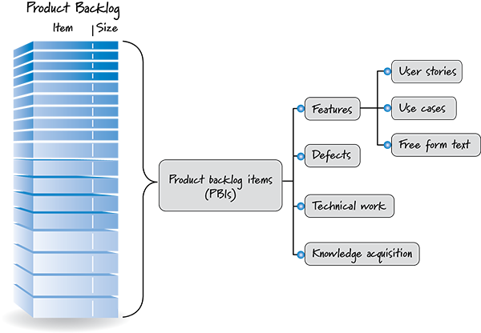
Breaking down the product backlog
The agile product backlog can be made up of a number of different items including features, bugs, technical debt and research.
The key thing is to keep breaking items down into smaller constituents that are easier to build and test.

Slide 7
Epics, stories, tasks, acceptance criteria
EPIC
A large user story that can’t be completed within one sprint. A number of smaller user stories sit beneath the epics.
USER STORY
A short, simple description of a feature from the users perspective.
The “AS A/I WANT/SO THAT” format makes it clear exactly who requires the feature, what the feature is and the benefit and value of it
TASK
Written by the team who are developing the stories, tasks describe the HOW.
ACCEPTANCE CRITERIA
Written against every story, conditions that must be met in order to satisfy the user story

Slide 8
Prioritisation Techniques

Slide 9
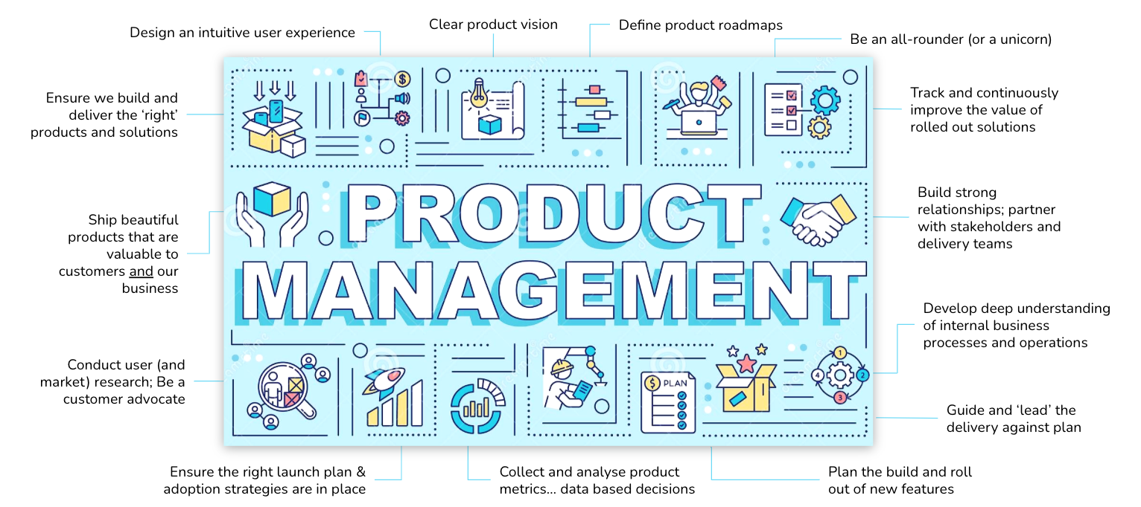
What is Product? Well a lot of prioritisation!

Slide 10
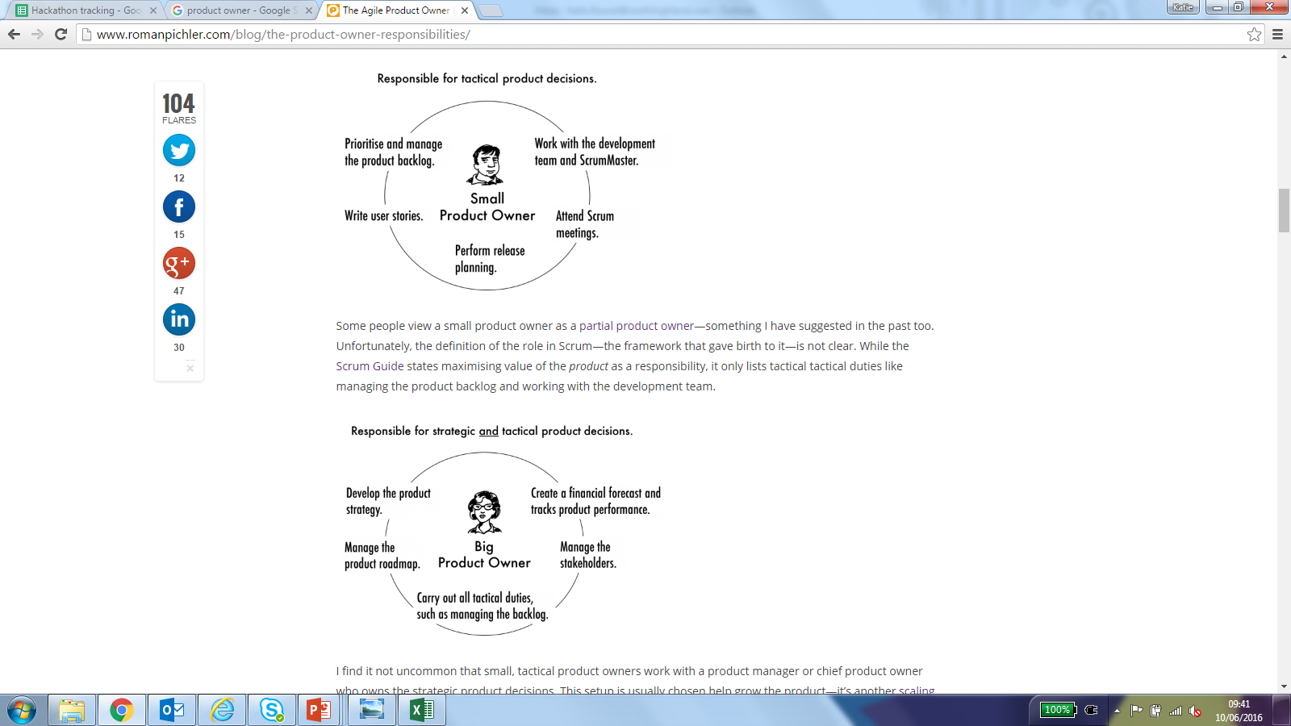
Product Manager Types
Whatever type of PM, you are prioritising and making decisions about what comes first is a big part of your role

Slide 11
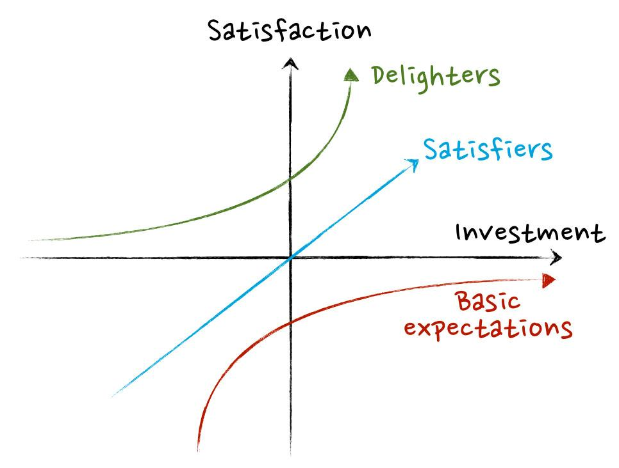
Kano Model
The focus of the Kano model is value to the customer. It splits features into 3 types:
Delighters: Delighters are characteristics that satisfy the customer when they are present in the product, but if they are not they will not cause dissatisfaction.
Satisfiers: Satisfiers are characteristics that can increase or decrease customer satisfaction. They are usually linked to performance. A good indicator from this quality is "the more the better".
Basic expectations: They should be present in your product. Their absence will frustrate the customer but their presence will not increase their satisfaction, since the customer expects that feature to be present.
But even internal facing products have users so don’t rule out using it just because your product isn’t used by external customers.

Slide 12
Agile Prioritisation
HIGH
VALUE
One of the underlying principles of agile is to get value to the customer early.
Therefore when prioritising you should always be focusing on the items which provide maximum value to the customer.
All risk in an Agile project should be front loaded.
Imagine having to cross a range of mountains but having the power to arrange them whichever way you want. If you’re smart, you’ll move the tallest one first, just to make sure you can do it. The rest should then be reasonably easier.
Med Priority
Low Risk
High Value
Top Priority
High Risk
High Value
Value
Low Priority
Low Risk
Low Value
Med Priority
High Risk
Low Value
LOW
VALUE
LOW RISK
HIGH RISK
Risk

Slide 13
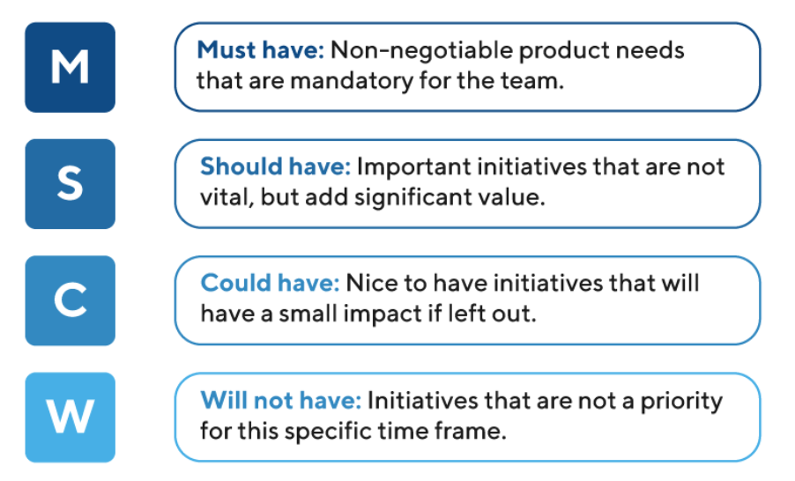
MoSCoW
MoSCoW is super simple framework and tends to work well with a variety of stakeholders, not just the ones that understand agile development.
Before scoring the stakeholders should agree which users are important and what their objectives are.
Having a clear idea of how long you have to get a feature ready and the resources available will further guide the prioritisation (although estimates are still estimates!).

Slide 14
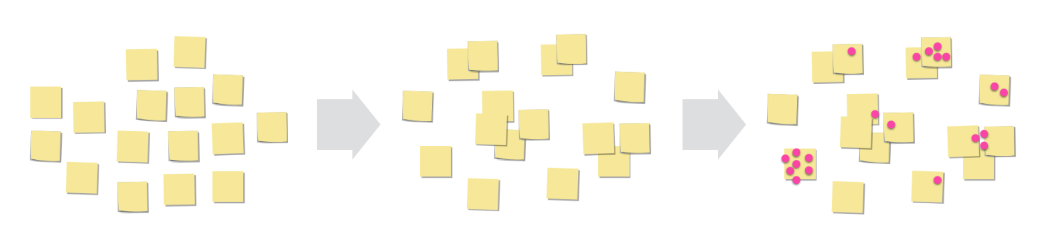
Voting
This is a really simple and equitable prioritisation tactic that can be used with big groups with potentially conflicting views and inputs.
It is also useful at the high level of ideas phase - sorting feature from feature rather than at the story level.
Everyone has a number of votes and they can use them against the features listed on your board. Decide on the number of dots to give based on the number of features.

Slide 15
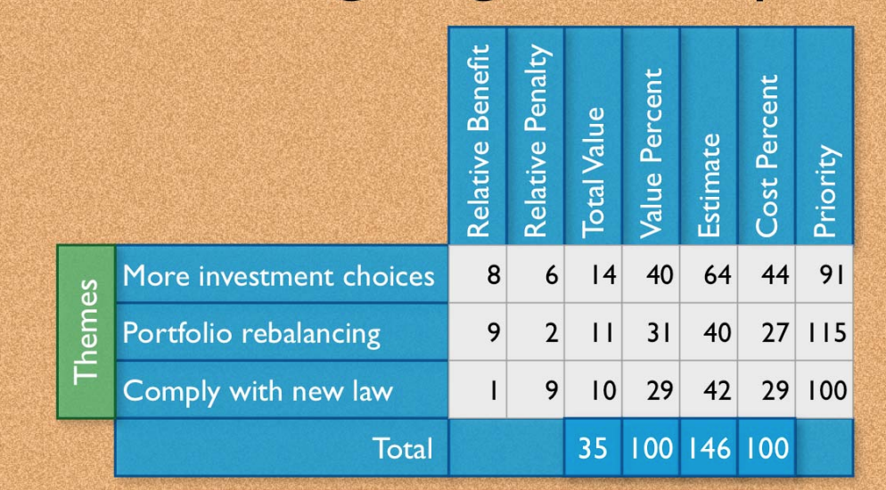
Weighting & Scoring
Weighting and Scoring involves measuring features against a set of value drivers and costs.
Benefits can be described as customer value, strategic value, revenue potential, cost reduction, or any other strategic objective your company may have.
Costs often include implementation or development effort as one of the key categories. You may also want to include the impact on ongoing operational costs, or even an initiative’s risk factor.
Priority = Relative Value / Relative Cost

Slide 16

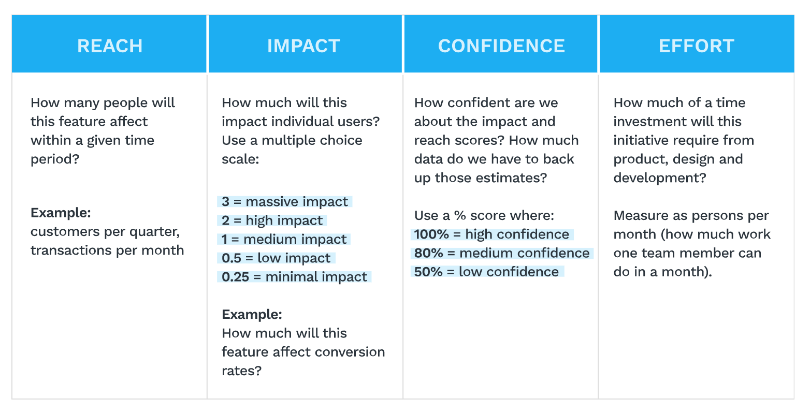
RICE scoring framework
RICE is another framework weighing benefit against cost. Unlike many other frameworks where it is tempting to rate you favourite projects highly RICE tries to reduce bias.
The Reach and Impact components challenges you to consider how many people will be affected and to what extent, while the Confidence allows you to include a measure of how sure or how proven this idea is.

Slide 17
Story Mapping

Slide 18
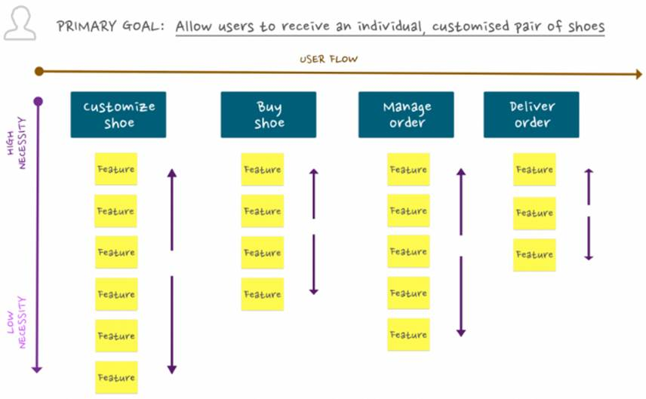
Story Mapping
Story Mapping is a technique coined by Jeff Patton who is a product specialist and agile evangelist.
It’s a way of visualising and bringing common understanding about the work to be done between the development team, product and stakeholders.
It involves mapping a the flow (usually a user flow) made up of epics / big stories / steps. These are then broken down into small stories or features which then ordered high to low priority.

Slide 19
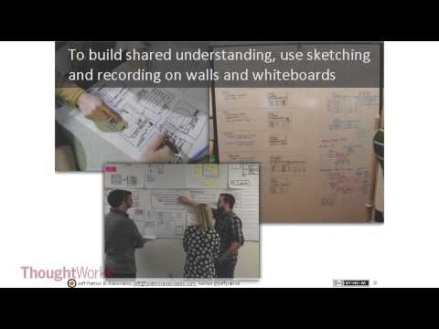
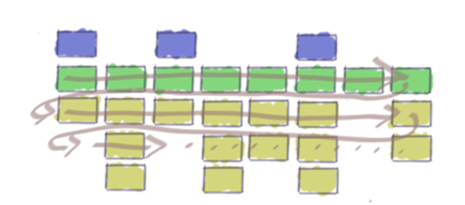
More on Story Mapping
Only got ten minutes? Read this blog... | Got 30 minutes? watch this video...
Blog Link

Slide 20

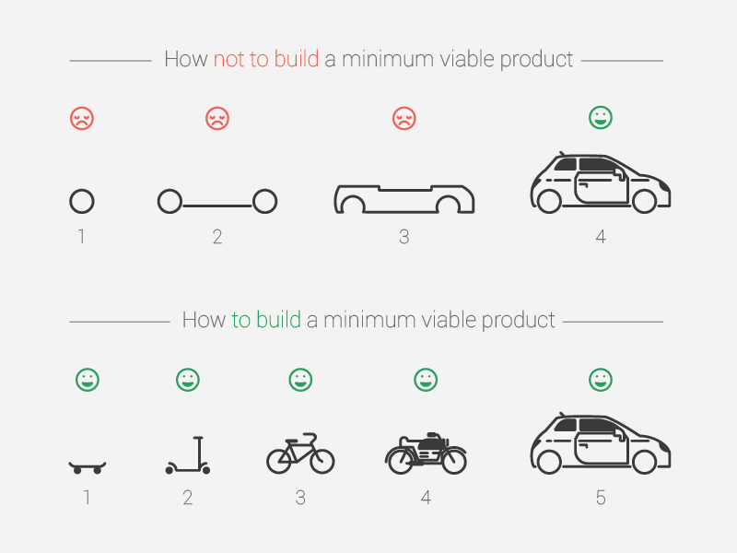
MVP
Notes:
With the MVP remember the following:
•Customers don’t know what you haven’t delivered
They are happy they are getting something
•Quick to market and early feedback
However we should also consider the MMP - Minimum Marketable Product. You need to strike a balance and find the point where…If the feature is any smaller it wouldn’t be marketable
Marketable means usable. If the UI for a product is so poor it jars the user experience it arguably isn’t marketable.

Slide 21
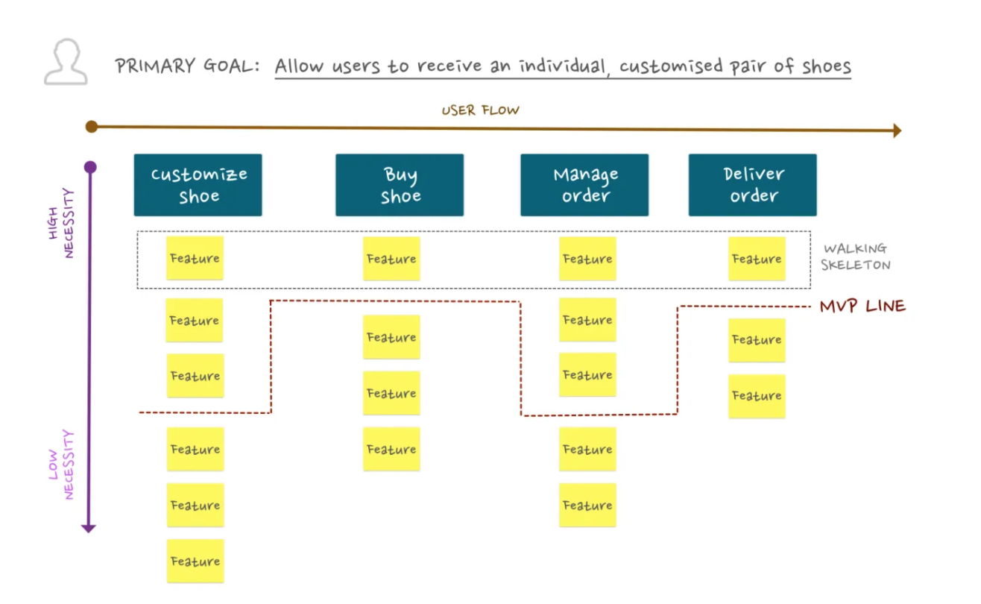
Drawing the MVP line
Technically the story mapping approach is about better communication but many find it is ideal for helping to decide what is in and out of scope, or what needs to be built first.
Prioritise the high value features at the top and the lower ones at the bottom. Then draw the line around which features would be in and out for your MVP.

Slide 22
HOMEWORK:
Pick a KOKO product (this can be one you have worked on or just interacted with) and brainstorm all the features you can think the user might want or need.
Timebox this to about 10 minutes. You should have between 10 and 20 features or big stories.

